Slide 1


Design Patterns
Wieger Wesselink, j.w.wesselink@tue.nl
Joris Geurts, j.geurts@fontys.nl

Slide 2
Design Patterns (recap)
Addressing the following problems:
reusability
maintainability
extensibility

Slide 3
Design Principles (recap)
Identify the aspects of your application that vary and separate them from what stays the same
Program to an interface, not an implementation
Strive for loosely coupled designs between objects that interact
Favor aggregation over inheritance
Classes should be open for extension, but closed for modification

Slide 4
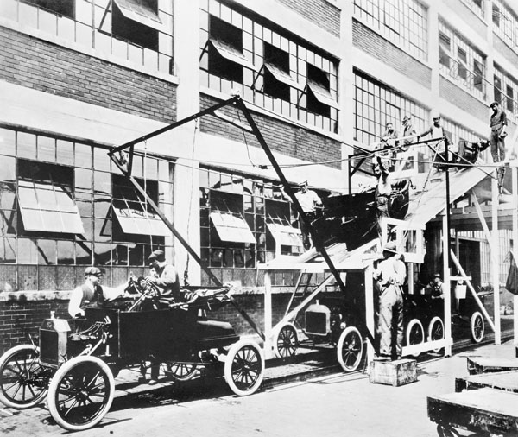
Abstract Factory

Slide 5

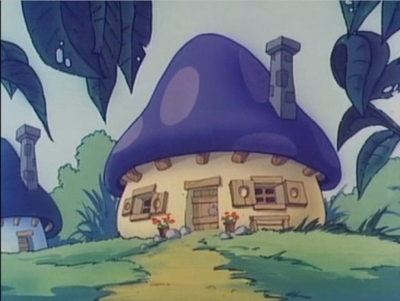


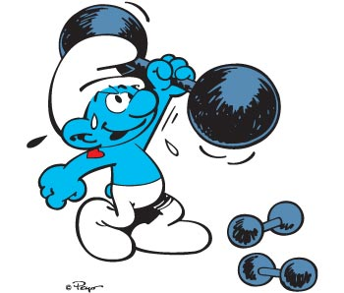

SmurfGame
class SmurfGame
{
public void run()
{
while (GameOver == false)
{
smurf = new Smurf();
smurf.jump();
...
house = new SmurfHouse();
...
smurfin = new Smurfin();
...
food = new SmurfFood();
...
sport = new SportSmurf();
...
gadget = new SmurfGadget();
}
}
}

Slide 6
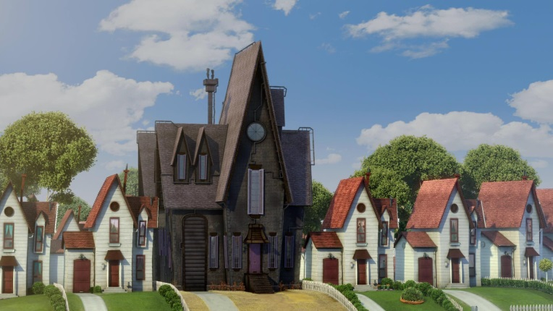





MinionGame
class MinionGame
{
public void run()
{
while (GameOver == false)
{
minion = new Minion();
minion.jump();
...
house = new MinionHouse();
...
female = new FemaleMinion();
...
minionFood = new Bananas();
...
sport = new SportMinion();
...
gadget = new MinionGadget();
}
}
}

Slide 7
Generic Game (trial I)
class GenericGame
{
public void run(Type type)
{
while (GameOver == false)
{
IFigure figure;
if (type == SMURF)
{
figure = new Smurf();
}
else if (type == MINION)
{
figure = new Minion();
}
figure.jump();
...
}
}
}
enum Type { SMURF, MINION };
interface IFigure
{
void jump();
void walk();
...
}
class Smurf implements IFigure
{
void jump() { ... }
...
}
class Minion implements IFigure
{
void jump() { ... }
...
}

Slide 8
Generic Game (trial II)
class GenericGame
{
public void run(IFigure figure, IFemale female, ...)
{
while (GameOver == false)
{
figure.jump();
...
female.sing();
...
}
}
}
interface IFemale
{
void sing();
...
}
class Smurfin implements IFemale
{
void sing() { ... }
...
}
class Miniette implements IFemale
{
void sing() { ... }
...
}

Slide 9
Generic Game (final)
class GenericGame
{
public void run(IFactory f)
{
while (GameOver == false)
{
IFigure figure = f.createFigure();
figure.jump();
...
house = f.createHouse();
...
female = f.createFemale();
...
food = f.createFood();
...
sport = f.createSportFigure();
...
gadget = f.createGadget();
}
}
}
interface IFactory
{
IFigure createFigure();
IHouse createHouse();
IFood createFood();
IFigure createSportFigure();
IFemale createFemale();
IGadget createGadget();
}

Slide 10
Using the factory
class SmurfFactory implements IFactory
{
IFigure createFigure()
{
return (new Smurf());
}
...
}
class MinionFactory implements IFactory
{
IFigure createFigure()
{
return (new Minion());
}
...
}
interface IFactory
{
IFigure createFigure();
IHouse createHouse();
IFood createFood();
IFigure createSportFigure();
IFemale createFemale();
IGadget createGadget();
}
interface IFigure
{
void jump();
void walk();
...
}
class Smurf implements IFigure
{
void jump() { ... }
...
}
class GenericGame
{
public void run(IFactory f)
{
while (GameOver == false)
{
IFigure figure = f.createFigure();
figure.jump();
...
}
}
}
public static void main()
{
IFactory factory = new SmurfFactory();
GenericGame game = new GenericGame();
game.run(factory);
}

Slide 11
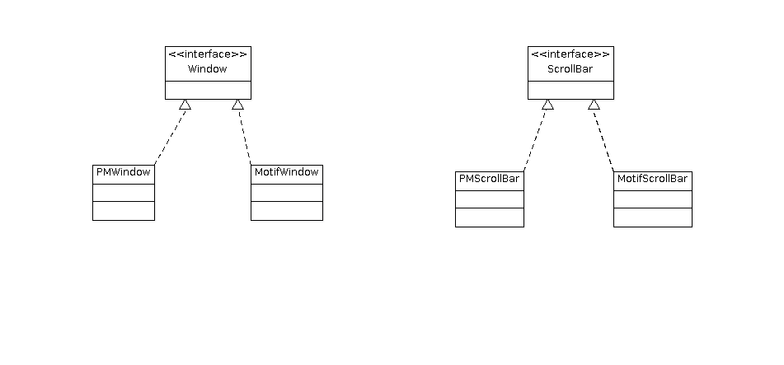
Abstract Factory for UI toolkit
Family of related or dependent objects

Slide 12
Abstract Factory Pattern
Provide an interface for creating families of related or dependent objects without specifying their concrete classes.

Slide 13
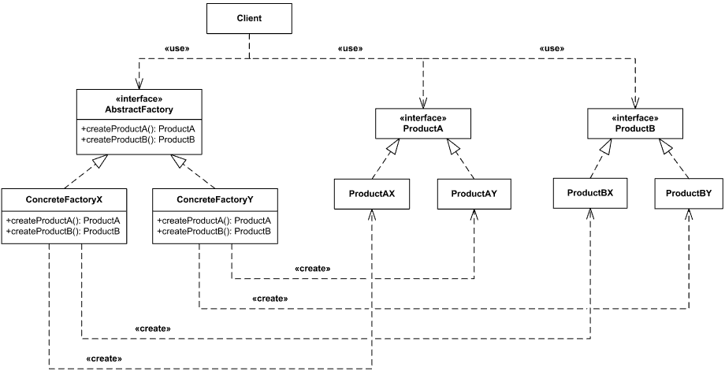
Abstract Factory solution

Slide 14
Abstract Factory consequences
+ It isolates concrete classes
+ It makes exchanging product families easy
+ It promotes consistency among products
- Supporting new kinds of products is difficult

Slide 15
Dependency Inversion Principle
"Depend upon abstractions. Do not depend upon concrete classes"
high level class
high level class
abstraction
low level class
low level class

Slide 16


Assignment
Apply the Abstract Factory pattern

